Slide 1


CSCE 692 Design Principles of Computer Architecture Lecture 4b Chap 3 – Tomasulo Algorithm
Dr. Scott Graham
AFIT/ENG
Notes adapted from
David Patterson
Electrical Engineering and Computer Sciences
University of California, Berkeley

Slide 2
Advantages of Dynamic Scheduling
Dynamic scheduling - hardware rearranges the instruction execution to reduce stalls while maintaining data flow and exception behavior
It handles cases when dependences unknown at compile time
it allows the processor to tolerate unpredictable delays such as cache misses, by executing other code while waiting for the miss to resolve
It allows code that compiled for one pipeline to run efficiently on a different pipeline
It simplifies the compiler
Hardware speculation, a technique with significant performance advantages, builds on dynamic scheduling (next lecture)

Slide 3
HW Schemes: Instruction Parallelism
Key idea: Allow instructions behind stall to proceed DIVD F0,F2,F4 ADDD F10,F0,F8 SUBD F12,F8,F14
Enables out-of-order execution and allows out-of-order completion (e.g., SUBD)
In a dynamically scheduled pipeline, all instructions still pass through issue stage in order (in-order issue)
Out-of-order completion caused WAW
Out-of-order execution causes WAR

Slide 4
Why Tomasulo Algorithm?
Implemented for the floating point unit of the IBM 360/91
About 3 years after CDC 6600 (1966)
Goal: High Performance without special compilers
Differences between IBM 360 & CDC 6600 ISA
IBM has only 2 register specifiers/instruction vs. 3 in CDC 6600
IBM has 4 FP registers vs. 8 in CDC 6600
Pipelined rather than multiple functional units (but conceptually viewed as multiple functional units)
Adder supports 3 instructions
Multiplier supports 2 instructions
Why Study? lead to Alpha 21264, HP 8000, MIPS 10000, Pentium II, PowerPC 604, i7

Slide 5
Tomasulo Algorithm
Hardware will detect and preserve dependencies (within a limited window of the instruction stream)
Hardware will check for resource availability
Independent instructions will be issued to the correct functional units
Correctness of execution guaranteed by hardware
Independent of compiler optimizations
Backward compatibility
Software scheduling: different machine configuration necessitate recompilation (or at least rescheduling)

Slide 6
Tomasulo Algorithm
Control & buffers distributed with Function Units (FU)
FU buffers called “reservation stations”; have pending operands
Registers in instructions replaced by values or pointers to reservation stations(RS); called register renaming ;
Renaming avoids WAR, WAW hazards
More reservation stations than registers, so can do optimizations compilers can’t
Results to FU from RS, not through registers, over Common Data Bus that broadcasts results to all FUs
Avoids RAW hazards by executing an instruction only when its operands are available
Load and Stores treated as FUs with RSs as well
Integer instructions can go past branches (predict taken), allowing FP ops beyond basic block in FP queue

Slide 7
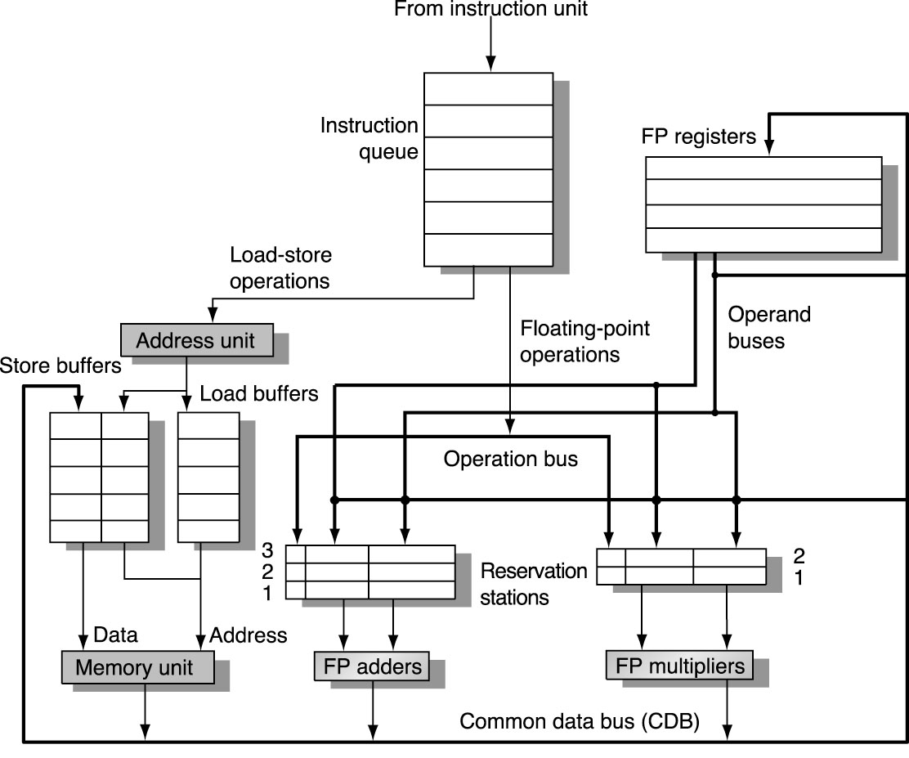
Tomasulo Organization
Notes:
Resolve RAW memory conflict? (address in memory buffers)
Integer unit executes in parallel

Slide 8
Reservation Station Components
Op—Operation to perform in the unit (e.g., + or –) on S1 and S2
Vj, Vk—Value of source operands
Either V or Q is valid for each operand
Qj, Qk—Reservation stations producing source registers (value to be written)
Note: No ready flags as in Scoreboard; Qj, Qk=0 => ready
Store buffers only have Qi for RS producing result
Busy—Indicates reservation station or FU is busy
Register result status—Indicates which functional unit (Qi) will write each register, if one exists. Blank when no pending instructions that will write that register.

Slide 9
Reservation Station Components
The format is essentially:
OPR.D Qi, Qj, Qk
Qi, Qj, and Qk Are essentially tags
Qi is not a register tag, it’s tags the FU producing the result
VALUES for Qj and Qk are held in Vj and Vk
Register result is literally a list where each element in the list refers to a FP Register and each value of each element is either blank or e.g., ADD1, ADD2, ADD3, MUL1, MUL2, DIV

Slide 10
Three Stages of Tomasulo Algorithm
1. Issue—get instruction from FP Op Queue
If reservation station free (no structural hazard), control issues instruction & sends operands (renames registers).
2. Execution—operate on operands (EX)
When both operands ready then execute; if not ready, watch Common Data Bus for result
3. Write result—finish execution (WB)
Write on Common Data Bus to all awaiting units; mark reservation station available
Normal data bus: data + destination (“go to” bus)
Common data bus: data + source (“come from” bus)
Does the broadcast
64 bits of data + 4 bits of Functional Unit source address
FU snags value on CDB if matches expected FU (produces result)
Notes:
For Issue: Note that remaining registers avoids name dependencies (anti-WAR and output-WAW)
For Execution, RAW eliminated since result is directly pulled off the bus and stored in the associated reservation station.

Slide 11
Detailed Tomasulo Pipeline Control
Instruction status
Wait until
Bookkeeping
Issue
Station or
buffer empty
if (RegisterStat[‘S1’].Qi ≠ 0)
{RS[r].Qj ← RegisterStat[‘S1’].Qi}
else {RS[r].Vj ← S1; RS[r].Qj ← 0}
if (RegisterStat[‘S2’].Qi ≠ 0)
{RS[r].Qk ← RegisterStat[‘S2’].Qi}
else {RS[r].Vk ← S2; RS[r].Qk ← 0}
RS[r].Busy ← yes;
RegisterStat[‘D’].Qi ← r;
Execute
(RS[r].Qj=0) and
(RS[r].Qk=0)
None — operands are in Vj and Vk
Write result
Execution completed
at r
and CDB available
∀x(if (RegisterStat[x].Qi=r)
{Regs[x] ← result; RegisterStat[x].Qi ← 0}); ∀x(if (RS[x].Qj=r) {RS[x].Vj ← result; RS[x].Qj ← 0}); ∀x(if (RS[x].Qk=r) {RS[x].Vk ← result; RS[x].Qk ← 0}); RS[r].Busy ← No
r = RS instruction is assigned

Slide 12
Tomasulo Example Cycle 0
3 Load/Buffers
3 FP Adder R.S.
2 FP Mult R.S.
Qi
ASSUME ‘EX’ CC’s: Load-2, Add-2, Mult-10, Div-40

Slide 13
Tomasulo Example Cycle 1

Slide 14
Tomasulo Example Cycle 2
Note: Unlike 6600, can have multiple loads outstanding

Slide 15
Tomasulo Example Cycle 3
Note: register names are removed (“renamed”) in Reservation Stations; MULT issued vs. scoreboard
Load1 completing

Slide 16
Tomasulo Example Cycle 4
Load2 completing; what is waiting for it?

Slide 17
Tomasulo Example Cycle 5
Instruction status
Execution
Write
Instruction
j
k
Issue
complete
Result
RS (Q)
Busy
Address
L.D
F6
34+
R2
1
3
4
Load1
No
L.D
F2
45+
R3
2
4
5
Load2
No
MUL.D
F0
F2
F4
3
Load3
No
SUB.D
F8
F6
F2
4
DIV.D
F10
F0
F6
5
ADD.D
F6
F8
F2
Reservation Stations (Q)
S1
S2
RS for Vj
RS for Vk
Time
Name
Busy
Op
Vj
Vk
Qj
Qk
2
Add1
Yes
SUB.D
R(F6)
M(45+R3)
0
0
0
Add2
No
0
Add3
No
10
Mult1
Yes
MUL.D
M(45+R3)
R(F4)
0
0
0
Mult2
Yes
DIV.D
R(F6)
Mult1
0
Register result status
Clock
F0
F2
F4
F6
F8
F10
F12
...
F30
5
FU
Mult1
M(45+R3)->0
Add1
Mult2

Slide 18
Tomasulo Example Cycle 6
Issue ADD.D here vs. scoreboard?

Slide 19
Tomasulo Example Cycle 7
Add1 completing; what is waiting for it?

Slide 20
Tomasulo Example Cycle 8

Slide 21
Tomasulo Example Cycle 9

Slide 22
Tomasulo Example Cycle 10
Add2 completing; what is waiting for it?

Slide 23
Tomasulo Example Cycle 11
Write result of ADD.D here vs. scoreboard?
Notes:
No WAR on DIV.D since DIV has value directly stored in Vk (as opposed to having to wait and read the register).

Slide 24
Tomasulo Example Cycle 12
Note: all quick instructions complete already

Slide 25
Tomasulo Example Cycle 13
Instruction status
Execution
Write
Instruction
j
k
Issue
complete
Result
RS (Q)
Busy
Address
L.D
F6
34+
R2
1
3
4
Load1
No
L.D
F2
45+
R3
2
4
5
Load2
No
MUL.D
F0
F2
F4
3
Load3
No
SUB.D
F8
F6
F2
4
7
8
DIV.D
F10
F0
F6
5
ADD.D
F6
F8
F2
6
10
11
Reservation Stations (Q)
S1
S2
RS for Vj
RS for Vk
Time
Name
Busy
Op
Vj
Vk
Qj
Qk
0
Add1
No
0
Add2
No
0
Add3
No
2
Mult1
Yes
MUL.D
M(45+R3)
R(F4)
0
0
0
Mult2
Yes
DIV.D
R(F6)
Mult1
0
Register result status
Clock
F0
F2
F4
F6
F8
F10
F12
...
F30
13
FU
Mult1
Mult2

Slide 26
Tomasulo Example Cycle 14

Slide 27
Tomasulo Example Cycle 15
Mult1 completing; what is waiting for it?

Slide 28
Tomasulo Example Cycle 16
Note: Just waiting for divide

Slide 29
Tomasulo Example Cycle 55 – TIME Warp!!

Slide 30
Tomasulo Example Cycle 56
Mult 2 completing; what is waiting for it?

Slide 31
Tomasulo Example Cycle 57
Again, in-order issue, out-of-order execution, completion

Slide 32
Compare to Scoreboard Cycle 62
Instruction status
Read
Execution
Write
Instruction
j
k
Issue
operands
complete
Result
L.D
F6
34+
R2
1
2
3
4
L.D
F2
45+
R3
5
6
7
8
MUL.D
F0
F2
F4
6
9
19
20
SUB.D
F8
F6
F2
7
9
11
12
DIV.D
F10
F0
F6
8
21
61
62
ADD.D
F6
F8
F2
13
14
16
22
Functional unit status
dest
S1
S2
FU for j
FU for k
Fj?
Fk?
Time
Name
Busy
Op
Fi
Fj
Fk
Qj
Qk
Rj
Rk
Integer
No
Mult1
No
Mult2
No
Add
No
0
Divide
No
Register result status
Clock
F0
F2
F4
F6
F8
F10
F12
...
F30
62
FU
Why does it take longer on Scoreboard/6600?

Slide 33
Tomasulo vs. Scoreboard (IBM 360/91 vs. CDC 6600)
Pipelined Functional Units Multiple Functional Units
(6 load, 3 store, 3 +, 2 x/÷) (1 load/store, 1 + , 2 x, 1 ÷)
window size: ≤ 14 instructions ≤ 5 instructions
No issue on structural hazard same
WAR: renaming avoids stall completion
WAW: renaming avoids stall completion
Broadcast results from FU Write/read registers
Control: reservation stations central scoreboard

Slide 34
Tomasulo Drawbacks
Complexity
Many associative writebacks (CDB) at high speed
Big load for a single bus
Can only writeback one result per clock
Performance limited by Common Data Bus
Multiple CDBs => more FU logic for parallel assoc writebacks

Slide 35
Tomasulo Loop Example
Loop: L.D F0 0 R1
MUL.D F4 F0 F2
S.D F4 0 R1
DADDI R1 R1 -8
BNEZ R1 Loop
Assumed latencies:
Multiply - 4
First load - 8 (e.g., cache miss)
Subsequent loads - 4 (cache hit)
Stores - 3
To be clear, will show clocks for DADDI, BNEZ
Assume branch predicted “taken”
Assume DADDI issue, execution, forwarding and write-back is done in one cycle (done to simplify this example).
Assumed ‘EX’ CC’s: First Load – 8, Subsequent – 4, Mult – 4, Stores – 3
Notes:
Note that times are from execute-to-ExecuteComplete

Slide 36
Loop Example Cycle 0
Assumed ‘EX’ CC’s: First Load – 8, Subsequent – 4, Mult – 4, Stores – 3
Notes:
2 iterations are “unrolled”
Assume
Predict taken
Int ALU ignored (except for issue time)

Slide 37
Loop Example Cycle 1
Assumed ‘EX’ CC’s: First Load – 8, Subsequent – 4, Mult – 4, Stores – 3

Slide 38
Loop Example Cycle 2
Assumed ‘EX’ CC’s: First Load – 8, Subsequent – 4, Mult – 4, Stores – 3

Slide 39
Loop Example Cycle 3
Assumed ‘EX’ CC’s: First Load – 8, Subsequent – 4, Mult – 4, Stores – 3

Slide 40
Loop Example Cycle 4
Assumed ‘EX’ CC’s: First Load – 8, Subsequent – 4, Mult – 4, Stores – 3

Slide 41
Loop Example Cycle 5
Assumed ‘EX’ CC’s: First Load – 8, Subsequent – 4, Mult – 4, Stores – 3

Slide 42
Loop Example Cycle 6
Note: F0 never sees Load1 result
Assumed ‘EX’ CC’s: First Load – 8, Subsequent – 4, Mult – 4, Stores – 3

Slide 43
Loop Example Cycle 7
Assumed ‘EX’ CC’s: First Load – 8, Subsequent – 4, Mult – 4, Stores – 3

Slide 44
Loop Example Cycle 8
Assumed ‘EX’ CC’s: First Load – 8, Subsequent – 4, Mult – 4, Stores – 3

Slide 45
Loop Example Cycle 9
Load1 completing; what is waiting for it?
Assumed ‘EX’ CC’s: First Load – 8, Subsequent – 4, Mult – 4, Stores – 3

Slide 46
Loop Example Cycle 10
Load2 completing; what is waiting for it?
Assumed ‘EX’ CC’s: First Load – 8, Subsequent – 4, Mult – 4, Stores – 3

Slide 47
Loop Example Cycle 11
Assumed ‘EX’ CC’s: First Load – 8, Subsequent – 4, Mult – 4, Stores – 3
Notes:
Iteration 3 stalls on MUL.D as no reservation station is available.

Slide 48
Loop Example Cycle 12
Assumed ‘EX’ CC’s: First Load – 8, Subsequent – 4, Mult – 4, Stores – 3
Notes:
Iteration 3 stalls on MUL.D as no reservation station is available.

Slide 49
Loop Example Cycle 13
Assumed ‘EX’ CC’s: First Load – 8, Subsequent – 4, Mult – 4, Stores – 3
Notes:
Iteration 3 stalls on MUL.D as no reservation station is available.

Slide 50
Loop Example Cycle 14
Mult2 completing; what is waiting for it?
Notes:
Iteration 3 stalls on MUL.D as no reservation station is available.

Slide 51
Loop Example Cycle 15
Mult2 completing; what is waiting for it?

Slide 52
Loop Example Cycle 16
Much going on here. Can you tell what happened?

Slide 53
Loop Example Cycle 17
Assumed ‘EX’ CC’s: First Load – 8, Subsequent – 4, Mult – 4, Stores – 3

Slide 54
Loop Example Cycle 18
Assumed ‘EX’ CC’s: First Load – 8, Subsequent – 4, Mult – 4, Stores – 3

Slide 55
Loop Example Cycle 19
Assumed ‘EX’ CC’s: First Load – 8, Subsequent – 4, Mult – 4, Stores – 3

Slide 56
Tomasulo Summary
Reservations stations: renaming to larger set of registers + buffering source operands
Prevents registers as bottleneck
Avoids WAR, WAW hazards of Scoreboard
Allows loop unrolling in HW
Not limited to basic blocks (integer units gets ahead, beyond branches)
Lasting Contributions
Dynamic scheduling
Register renaming
Load/store disambiguation
360/91 descendants are Pentium II; PowerPC 604; MIPS R10000; HP-PA 8000; Alpha 21264

Slide 57
ILP Summary (up to now)
Leverage Implicit Parallelism for Performance: Instruction Level Parallelism
Loop unrolling by compiler to increase ILP
Branch prediction to increase ILP
Dynamic HW exploiting ILP
Works when can’t know dependence at compile time
Can hide L1 cache misses
Code for one machine runs well on another

